Slide 1
Online Learning Centre
Presented By
Abhinaya K

Slide 2
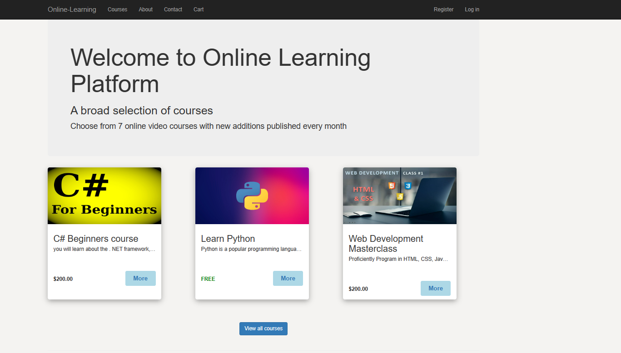

Slide 3
Module Description
1.User Registration Page
2.Login Page
3.Home Page
4.Course Page
5.Contact Page
6.Cart Page

Slide 4
Software Requirements
Database -Microsoft SQL server Management Studio
Visual Studio-2022
Data Access Layer-ASP.NET Core Entity framework

Slide 5
Features
Add and Delete operations in Course Details page.
Add to card in Shop page.
Update users Details
Feedback form Details
Login page with Authentication

Slide 6
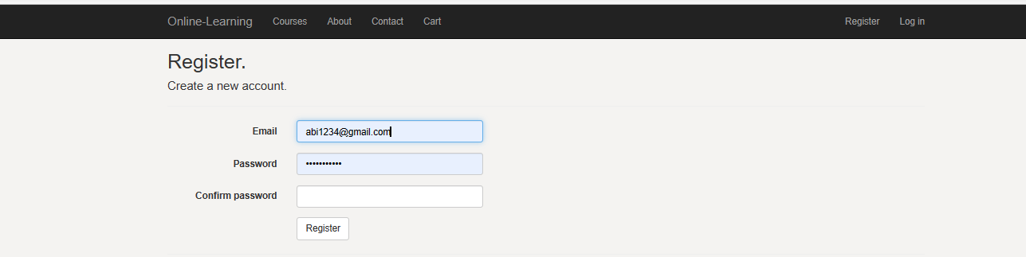

Slide 7
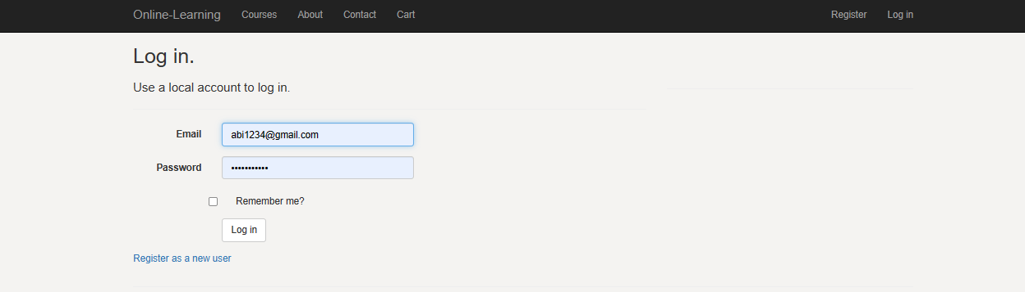

Slide 8
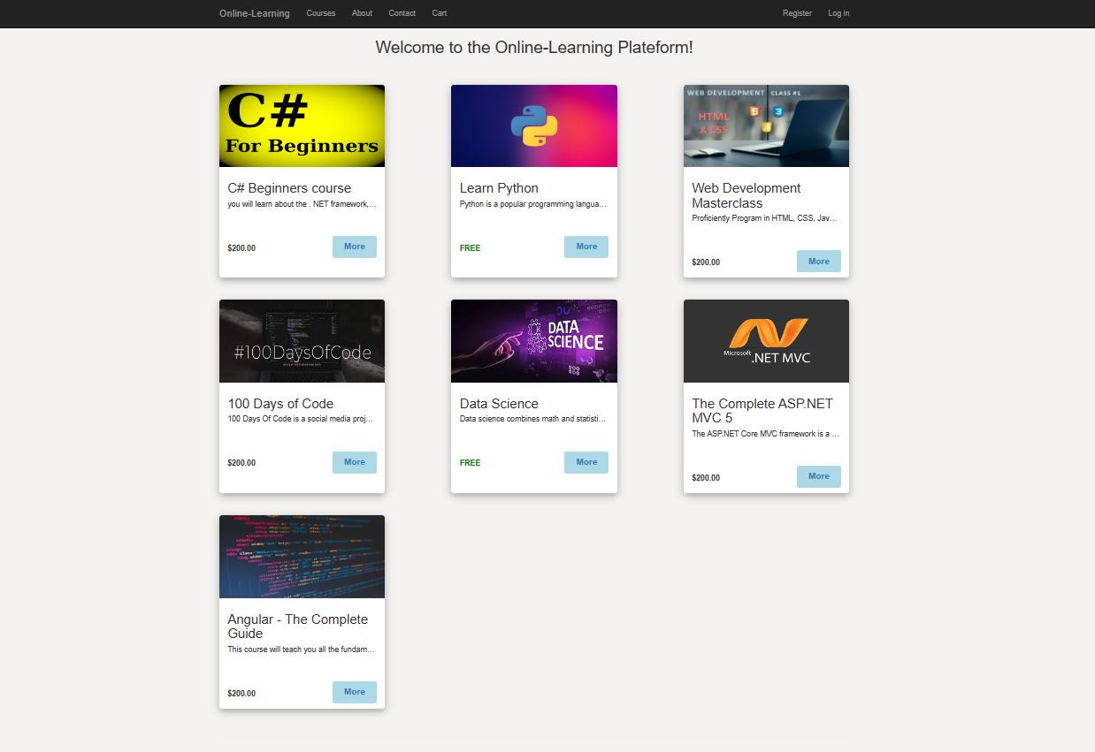

Slide 9
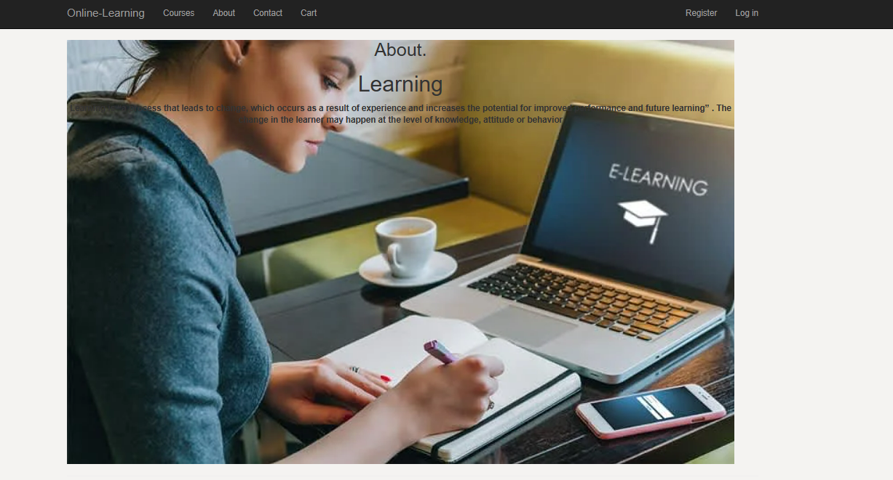

Slide 10
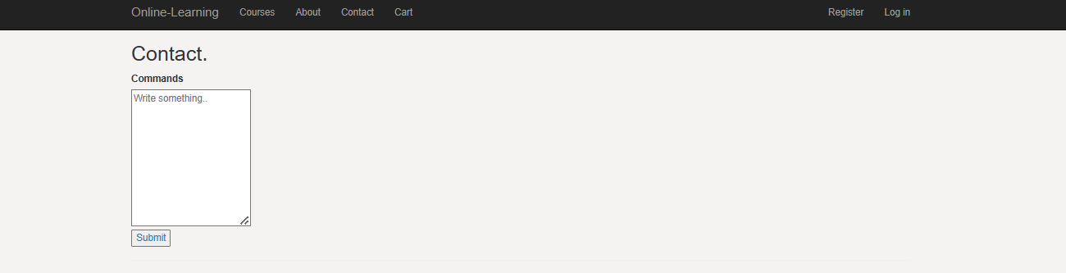

Slide 11
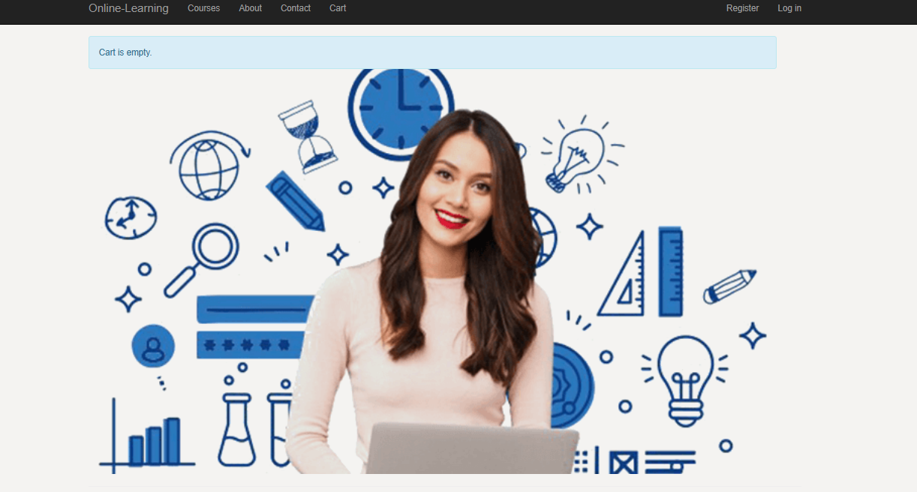

Slide 12
Advantage of Online Training Centre
Motivation
Flexibility and freedom
Saves Time and schedule.
Better Communication
Affordability-Cost

Slide 13

ThankYou

